Slide 1
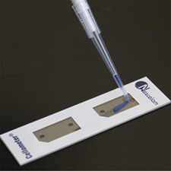
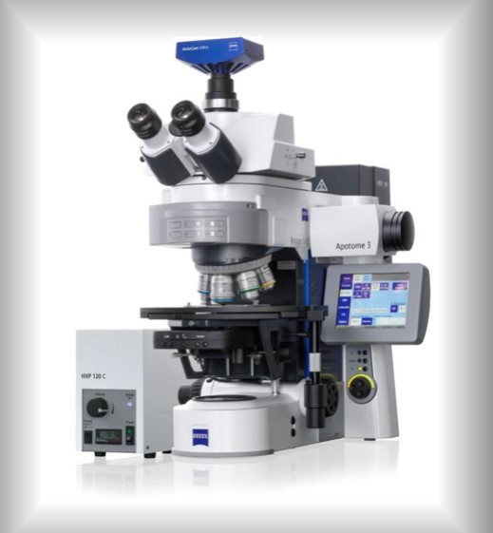

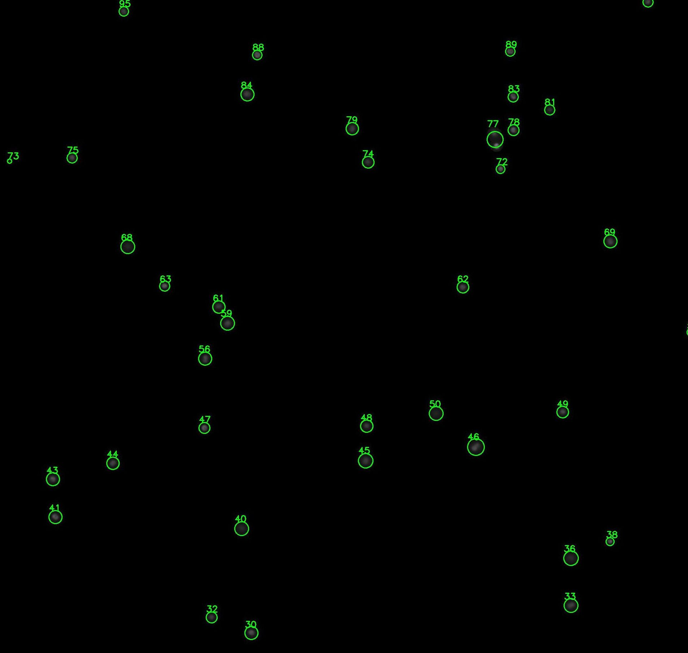
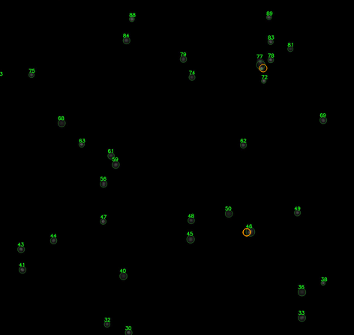
Pipette the cell suspension sample to the counting chamber
Perform fluorescence microscopy imaging
Analyze the images by this tool (see the instruction below)
Review the results and verify if all cells were identified properly
In case some cells were missed, perform manual correction

Slide 2
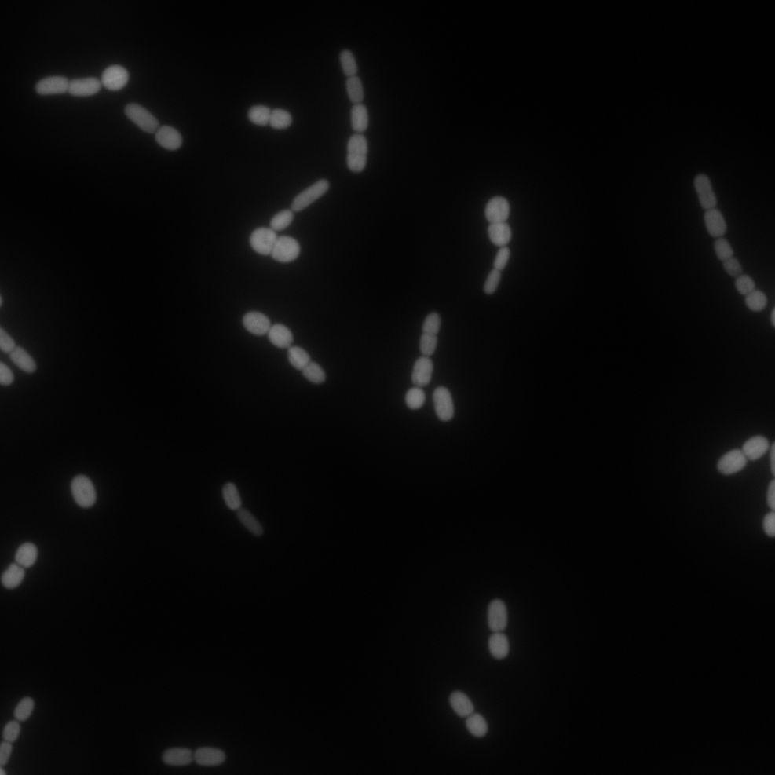
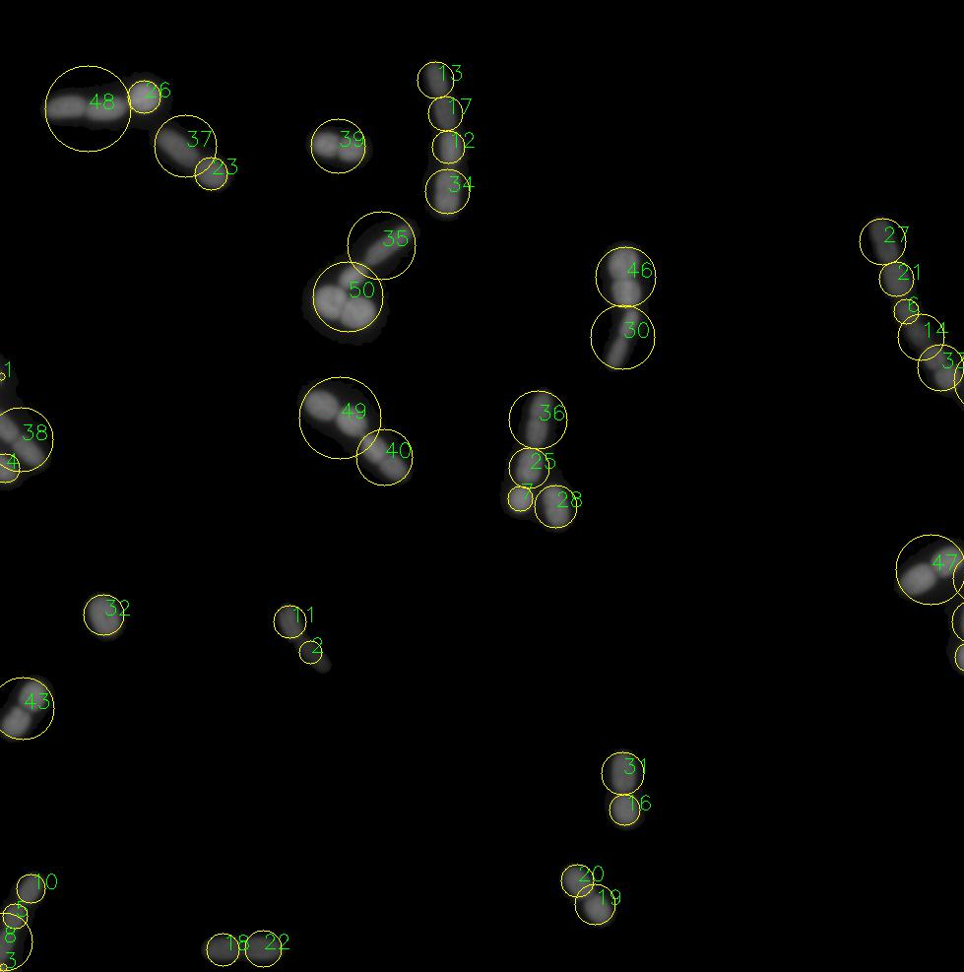
Pipette the cell suspension sample to the counting chamber
Perform fluorescence microscopy imaging
Analyze the images by this tool (see the instruction below)
Review the results and verify if all filaments were split properly and all individual cells were identified
In case some cells were missed, perform manual correction

Slide 3
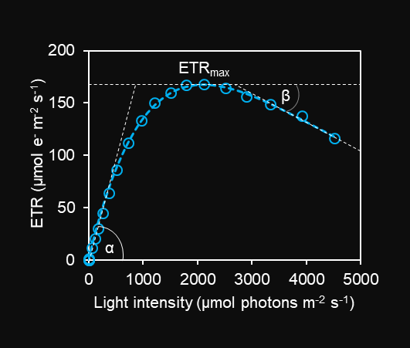
Rapid light curve example

